Slide 1

Fellowship of the Heart
Getting Started — the Four Connects, walked around the table on alternating evenings
Evening Series 2026–27 · at the Tittle home · v1.5E DRAFT
All Scripture: ESV · The Companion lesson plans carry the full scripts — these slides carry the room
P1
Notes:
DECK TITLE · pre-session · DIVIDER
On screen as the room assembles on night one. All Scripture ESV; the plans carry the scripts; these slides carry the room — and these notes carry you.

Slide 2
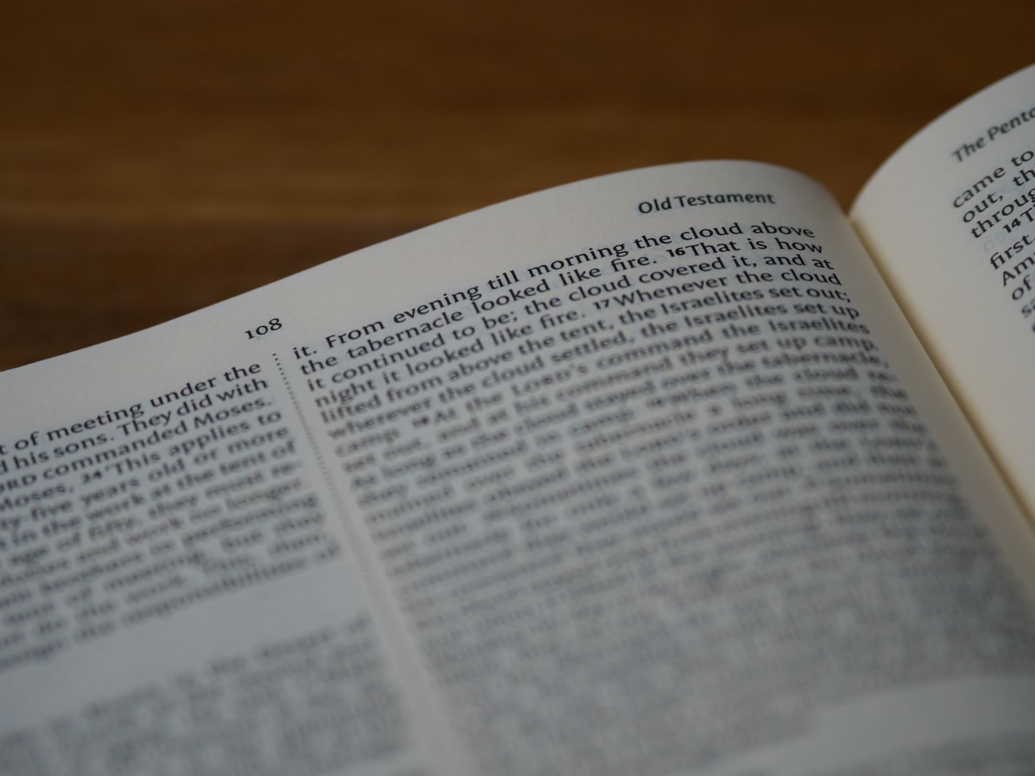
SESSION 7–8
Hearing God in Scripture — PROAPT, I & II in One Evening
PROAPT — the systematic practice of hearing; walked together, then twice through in pairs — the current-condition form
Quarter 2: Connect with God
P2
Notes:
S7–8 COMBINED · pre-session · DIVIDER
On screen through dinner and as the circle forms. Greet at the door — the slide holds the room.

Slide 3




Where We Are — the Four Connects
Session 7–8 combined stands in the third box — Connect with God — the practice walked twice in one evening, teen-led. Each connection makes the next one real (Matt. 22:37–40).
P3
Notes:
S7–8 COMBINED · WELCOME · LEAD: CONTAINER HOLDER · GROUNDING — every session opens on this map
BEATS:
1. Locate tonight on the map, plainly: Session 7–8 combined stands in the third box — Connect with God — and the practice is walked twice in one evening, teen-led.
2. The four boxes are one journey — each connection makes the next one real — rooted in the two great commandments: love God, love neighbor (Matt 22:37–40).
3. This is also the 'where we are on the map' minute the welcome owes any newcomer.
CUES: Two minutes at most; then tonight's road.

Slide 4
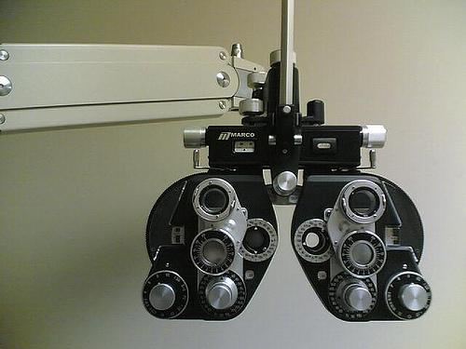

Week 7 — My Story: The Eye Test
“The more I obey what I have heard, the finer print I can read.”
— the founder’s story, told live
Hearing God is a practice that grows with obedience — tonight we learn the practice.
P4
Notes:
S7 · 7:00–7:08 · LEAD: CONTAINER HOLDER
BEATS: 1. This is John's personal eye-test story — his own testimony of learning to hear God, framing today's turn from Self and Others toward God. 2. Keep it to about one minute; the story serves the practice, not the reverse. 3. Land it and move to Today's Road.
SUB: Never perform someone else's testimony. Tell your own hearing-growth story in one minute — or skip straight to the pull-quote on the slide, read it, and move.

Slide 5

Session 7–8 — Tonight’s Road
1 Welcome and centering
2 Re-entry — and the room reads itself
3 Romans 10:17 — the chain
4 PROAPT walked together
5 Bridge to the pairs and pair structure
6 PROAPT in family pairs — two passes, two passages
7 Tell step — sharing in the pair
8 Merge and homework
9 The Leader Feedback Round — both leaders
10 Closing container
P5
Notes:
S7–8 COMBINED · 7:00–8:30 · LEAD: BOTH LEADERS
BEATS:
1. The re-entry evening AND the practice, twice — hearing is a skill, and skills take reps: rep one walked together, rep two in the pairs on a second passage.
2. Shape: open, check-in, Romans 10:17 chain, PROAPT walked together (Mark 1:14–20, teen-led), bridge, two 12-minute passes in family pairs (pass two: Mark 2:1–12), tell step, merge, daily-PROAPT commissioning, feedback, close.
3. The current-condition form: this room's teens lead the walk-through. The separate second-running evening (Session 8) is held in reserve for a larger room of newer people.
CUES: Passage cards for both passages at each seat; the Pair Card printed, one per pair and a spare; the journal Week 7 pages carry the daily template.

Slide 6
Opening Container — the Eight Steps
1 Welcome — five minutes to open the container
2 Phones silenced and put away
3 Stand in a circle
4 One-word check-in — how you actually are, right now
5 Put out / bring in — set something down; bring a blessing in
6 Spoken commitment: “I am here. I am paying attention. I am willing to be moved.”
7 Opening prayer — “Holy Spirit, you are welcome here. Speak. We are listening.”
8 Sit. Begin.
P6
Notes:
S7 · 7:00–7:08 · LEAD: CONTAINER HOLDER
BEATS: 1. Aaronic blessing first. 2. Container restated SLOWLY — Safe, Present, Clear, Intentional; a container that sat empty over a break needs a minute to hold again. 3. Frame Week 7 as a turn: the interior work prepared us; today hearing God becomes a learnable skill — six steps, a practice that works.
CUES: Run the re-entry gently; let the room land before moving on.
PAIR LEAD: name the leading pair in the welcome — two leaders hold tonight, and the room will see the evening handed back and forth between them; that is the design. The pair practices the session together beforehand.

Slide 7

Re-Entry Check-In
• First gathering of Quarter 2 — the container re-held slowly after the break
• “Take ninety seconds: one sentence about the Examen, or about how the break treated your practice, or anything that has shifted.”
– “Thinned out over the break is a completely normal answer — the practice picks up where you are.”
• A parent starts the round — pass-anytime holds
• Week 6 still sitting heavy? “The team is here. Find one of us before you leave tonight.”
P7
Notes:
S7 · 7:25–7:34 · LEAD: CONTENT PRESENTER
BEATS: 1. Ninety seconds each: one sentence on the Examen, how the break treated the practice, or anything shifted. 2. Say it: 'thinned out over the break' is a completely normal answer — the practice picks up where you are. 3. Take 2–3 contributions, then move. 4. Open door: anyone still carrying Week 6, find a Companion before leaving today.
CUES: Arranged parent opens (check the Run Card) — never cold-call a teen; pass-anytime holds.

Slide 8
The Round, for All of Us
Same process as every week’s leader reflection — now for the group:
1 What’s working well that we ought to keep doing next quarter?
2 What could we do differently that would make things even better?
3 What would you tell somebody else about what this group is like?
The leader answers first, same as always. Any question, any order.
P8
Notes:
S7 · 7:25–7:34 · LEAD: CONTENT PRESENTER
BEATS:
1. After the break check-in: 'the three questions that went home two weeks ago — let's apply the process we use for the leader reflection to ourselves, as a group.' One rule, warmly: the group, never any one person.
2. The leader answers FIRST — all three, briefly, a story or moment attached to each. Modeling that answers come with what you saw is the whole teaching.
3. The room answers, any question, any order; the Co-Companion scribes keep · change · tell for tonight's debrief sheet. Thursday's Call maps their answers to the three signs — the team's side of the paper, never the room's.
CUES: a bare verdict → 'say more — what did that look like?' · drifts toward a person → 'the group, never any one person — if something needs a name, bring it to one of us after.'
POCKET (only if a gap matters): 'when hard things landed this quarter, how did we do?' · 'what would a brand-new family feel in their first ten minutes with us?'
GUARD: receive everything without correcting — glowing or grim, it is data, not a draft the team edits. Close: 'a group that knows what it has can choose to keep it.'
SUB: the answers modeled first are the leader's own — a substitute answers honestly for themselves.

Slide 9
Romans 10:17 — The Chain
• One short verse, three steps: Word → Hearing → Faith — the order matters
• Not trying harder, not emotional experience — faith is a fruit of a particular practice
• How much of our “Bible time” is actually hearing, and how much is reading without hearing?
• Hearing is a skill — skills develop with practice
• The practice: PROAPT — Pray, Read, Observe, Apply, Pray again, Tell (Truro Church, 1980s)
ROMANS 10:17
“So faith comes from hearing, and hearing through the word of Christ.”
P9
Notes:
S7 · 7:34–7:40 · LEAD: CONTENT PRESENTER
BEATS: 1. Read Romans 10:17 aloud, slow. 2. Teach the chain: Word, Hearing, Faith — faith is the fruit of a practice, not of trying harder. 3. John 10:27 — the sheep hear because they are His; the quiet road is still open, any evenings, any Companion. 4. Hearing is a skill; write PROAPT on the board: Pray, Read, Observe, Apply, Pray again, Tell. 5. Preview: whole room works Mark 1:14–20 together, then family pairs work the same passage.

Slide 10

PROAPT Walked Together — Mark 1:14–20
1 Pray — “Holy Spirit, you are welcome here. Speak. We are listening.”
2 Read — slowly, to receive it; don’t analyze yet
3 Observe — two layers, in order: first the data (who, what, when, where — straight off the page), then the interpretation — what stands out or surprises you in it
4 Apply — “What does this passage mean FOR YOU, TODAY, in your specific life?” — logos becomes rhema
5 Pray again — tell God what you heard, what you are willing to do, what you’re struggling to be willing to do
6 Tell — the most-often-skipped step; hearing spoken aloud has a different staying power
P10
Notes:
S7 · 7:40–7:49 · LEAD: CONTENT PRESENTER
BEATS: 1. The most important teaching block of the night — walk all six steps on Mark 1:14–20, everyone on handout H7.2. 2. PRAY 90s (silence, then invite the Spirit aloud). READ 90s. OBSERVE 3 min — data first, then what surprises; take 3–4 shares, receive without evaluating. 3. APPLY 3 min — for YOU, today, specifically; 2–3 shares. 4. PRAY AGAIN 90s silence. TELL 60s — happens in the pairs later. 5. Hold the silences; do not rush.
CUES: If an Apply goes vague or grand, push gently for one specific concrete application.
WHY: the order protects the hearing — what the text says before what it means. 1. PRAY — we come to hear, not to extract; the Word is His. 2. READ — let it land whole before taking it apart. 3. OBSERVE, the data — the ground: what the page actually says, checkable by anyone; skipping it is where most misreadings start. OBSERVE, the interpretation — what it meant in its own world before it means anything in ours. 4. APPLY — where reading becomes hearing: one specific thing, for me, not for someone else. 5. PRAY AGAIN — hearing becomes a response; obedience starts here. 6. TELL — spoken hearing stays, and someone else hears what you heard. Full page: “PROAPT — What Each Step Is For” (Planning).

Slide 11
Bridge to the pairs — Pair Structure
• Pair up in your family pair — parent with teen, from your own family, by default
• One Reader, one Listener — Reader leads the six steps; after twelve minutes, switch
• Your Lead Companion settles the pairs and completes any odd numbers
P11
Notes:
S7 · 7:49–7:50 · LEAD: CONTENT PRESENTER · TRANSITION
BEATS: 1. Explain the pair shape: parent with your own teen by default; one Reader, one Listener; switch at twelve minutes. 2. Name one timekeeper before anyone moves — the container holder by default, or anyone the leaders pick — who calls the switch at 8:02, the Tell at 8:13, and back in the circle at 8:19. 3. Hand each pair a Pair Card. 4. Pray and send.
CUES: Lead Companions settle odd numbers across families. Pairs always, even in a small room: the practice is one Reader and one Listener, and a circle cannot give that.

Slide 12
PROAPT in Family Pairs
1 First pass (12 min) — Reader leads PROAPT; Listener works alongside without interrupting
2 Reader’s Tell at the end goes to the Listener — one sentence
3 Switch roles — the second passage: Mark 2:1–12, the paralytic
4 Second pass (12 min) — same structure, roles reversed
• Stuck on Observe? “What’s one specific word or phrase that caught your attention?”
• “Slow down. The Spirit isn’t in a hurry.” — and if you finish early, get reps with another passage
P12
Notes:
S7 · 7:50–8:13 · LEAD: CONTENT PRESENTER · PAIRS
TIME TARGETS (the timekeeper calls them): pass one 7:50–8:02; switch at 8:02; pass two 8:02–8:13; the Tell, still in the pair, 8:13–8:19; back in the circle at 8:19 for the merge. If the room is running late, keep the two passes equal and shorten both rather than drop the second.
BEATS: 1. First pass 12 min: Reader leads the six steps, Listener works alongside without interrupting; Reader's Tell goes to the Listener, one sentence. 2. Switch roles; second pass 12 min, same or new passage. 3. Companions float: stuck on Observe — 'one word or phrase that caught you'; stuck on Apply — 'one specific situation right now'; rushing — 'the Spirit isn't in a hurry'; finished early — another passage, get reps.
PRINT: the Pair Card (Leader Notes folder) carries this slide, the six steps, the passages, the times and the stuck-prompts, so each pair has it in hand away from the screen.
CUES: If something heavy surfaces, honor it briefly and follow up after the close — do not process it in the pair.
REPS (combined form): hearing is a skill, and skills take reps — pass one was rep one; pass two is rep two, on a fresh passage. A passage speaks differently on a second hearing; tonight the room tests that inside one evening.

Slide 13
Tell Step — Sharing in the pair
• Back in the family pair — each of us tells ONE specific thing we heard tonight
• “Specific. One sentence. We listen to receive, like Week 3.”
• A parent opens the round — arranged beforehand, never a cold call on a teen; pass-anytime holds
• Receive without preaching — “We hear that.” “Thank you for naming that.”
• “What we heard tonight is not just for us — it is given to us to walk out.”
P13
Notes:
S7 · 8:13–8:19 · LEAD: CONTENT PRESENTER · PAIRS
BEATS: 1. Re-form pairs out of pairs. 2. Each person tells ONE specific thing they heard today — one sentence, witnessed. 3. Receive each with 'We hear that' or 'Thank you for naming that' — no preaching, no interpreting. 4. Close the pair: what we heard is given to be walked out this week.
CUES: Arranged parent opens the round (check the Run Card) — never cold-call a teen; teens choose their own depth; pass-anytime holds.

Slide 14

Merge and Homework Practice
• One word each — not what you heard (that’s yours), but what tonight’s practice was like; a parent begins
• Daily PROAPT — one passage per day, every day, for the next week — five to ten minutes
• The journal Week 7 pages have a daily PROAPT template
• Passage paths on the handout — the Gospel of Mark, the Sermon on the Mount, or Romans 8
• Commit aloud to a specific time of day — “Morning before school” / “Right after dinner”
• “The chain only works if we work it.”
P14
Notes:
S7 · 8:19–8:20 · LEAD: CONTENT PRESENTER
BEATS: 1. One word each — not what you heard (that is yours), but what the practice was like. 2. Introduce daily PROAPT: one short passage, five to ten minutes, every day — the journal Week 7 pages have the template. 3. Hold up H7.3: passage paths for teens and parents. 4. 'The chain only works if we work it.'
CUES: Arranged parent begins the word round; anyone may pass.

Slide 15
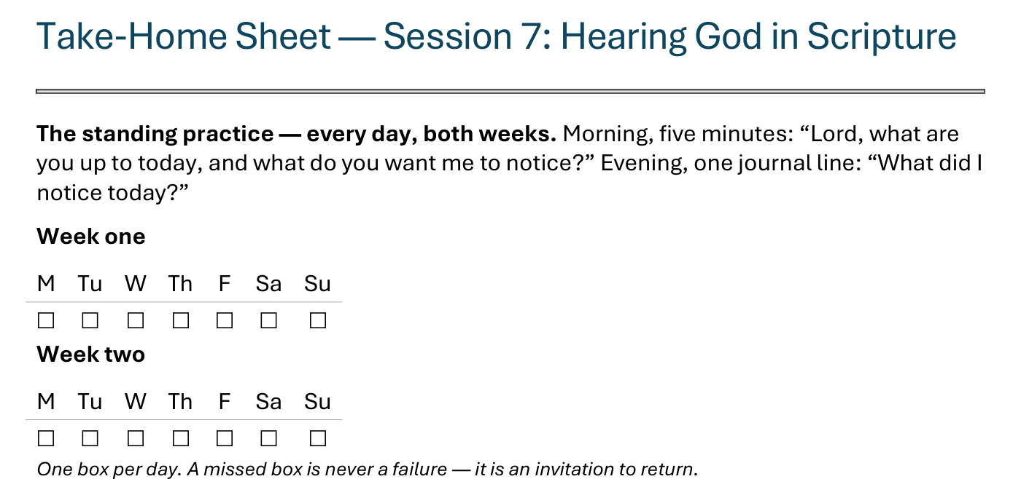
The Take-Home Sheet — the Daily Rhythm
Handed out now — this is the sheet in your hands.
P15
Notes:
S7 · COMMISSIONING · LEAD: CONTENT PRESENTER
BEATS:
1. The sheet on the screen is the sheet in their hands — walk it, don't read it.
2. The standing rhythm first: the morning question, the evening journal line — one box per day on the week-grids.
3. A missed box is never a failure — it is an invitation to return.
CUES: The four parts are the next slide.

Slide 16
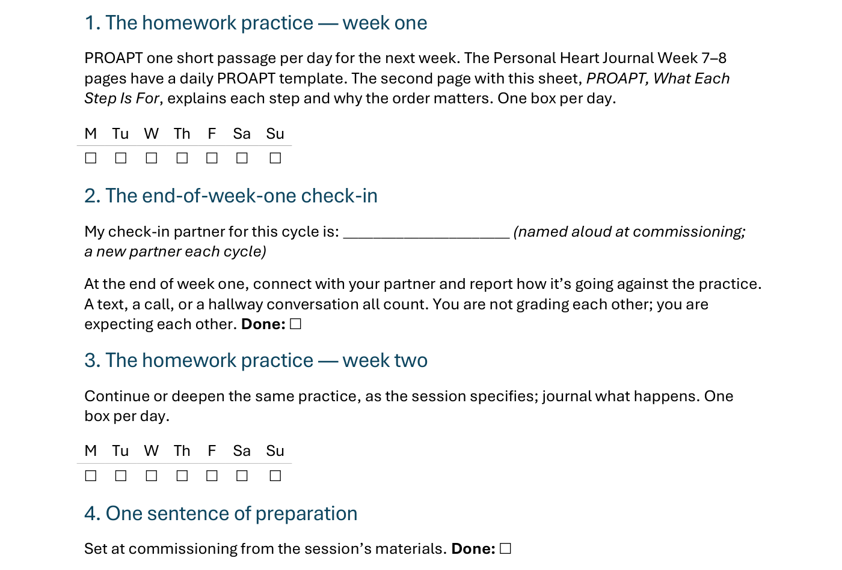
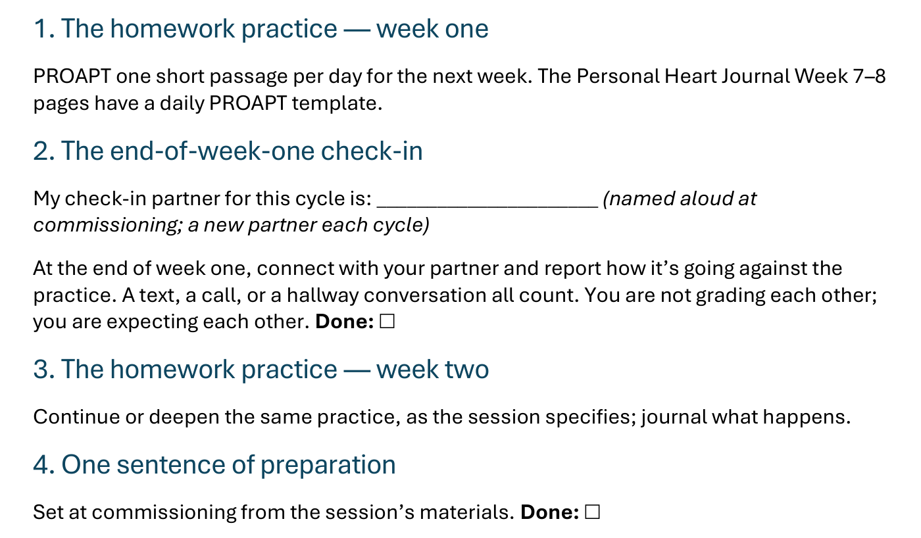
The Take-Home Sheet — the Four Parts
One practice at a time — and a partner expecting you at the end of week one.
P16
Notes:
S7 · COMMISSIONING · LEAD: CONTENT PRESENTER
BEATS:
1. The four parts, in order: the homework practice, week one; the end-of-week-one check-in; the homework practice, week two; one sentence of preparation.
2. Check-in partners are named aloud before leaving this slide — the sheet has the line to write the name.
GUARD: The sheet-walk, not a re-teach.

Slide 17

The Leader Feedback Round
• Two rounds, same as every session — the container holder first, then the content presenter: three things each
– “What I think went well tonight: ______”
– “What I’d do differently next time: ______”
– “If I were to teach tonight’s process to someone, I would tell them: ______”
• Then the room — the same two questions about tonight
• The leaders receive without defending — “thank you” is the whole response
P17
Notes:
S7 · 8:24–8:28 · LEAD: BOTH LEADERS
BEATS: 1. Same round every week, leader first: what went well today; what I'd do differently; what I'd tell someone teaching this process. 2. Then the room, same two questions — two or three voices is plenty. 3. Receive without defending — 'thank you' is the whole response.
CUES: May be dropped if the room's energy needs something else; dropping it twice running goes to the team debrief.

Slide 18
Closing the Container + Aaronic Blessing
• We close the way we opened — the container, six steps:
1 Stand again — same circle, same posture as the open
2 One-word landing — compare it to your opening word
3 The one thing you are taking from tonight
4 The one practice — committed aloud, or modified to one you will actually keep
5 Blessings — eyes on the person, not the screen: say what is on your heart for them. Specific, witnessed, short
6 Closing prayer — and the Aaronic blessing, spoken over each other, face to face
THE AARONIC BLESSING — NUMBERS 6:24–26
“The Lord bless you and keep you;
the Lord make his face to shine upon you, and be gracious to you;
the Lord lift up his countenance upon you, and give you peace.”
P18
Notes:
S7 · 8:28–8:30 · LEAD: CONTAINER HOLDER
BEATS: 1. Bridge the weeks: last week we named hard places, today we practiced hearing — both are real, both are how the Father walks us home; the place named last week is the place PROAPT will keep speaking into. 2. Blessings: turn away from the screen and face the person. Nothing to read — say what is in front of you for this person, specific and short. Then the Aaronic blessing, hands up. 3. Send: 'PROAPT one passage tomorrow. See you evenings.'
CUES: Stay accessible after the close for anyone still carrying Week 6.

